Slide 1
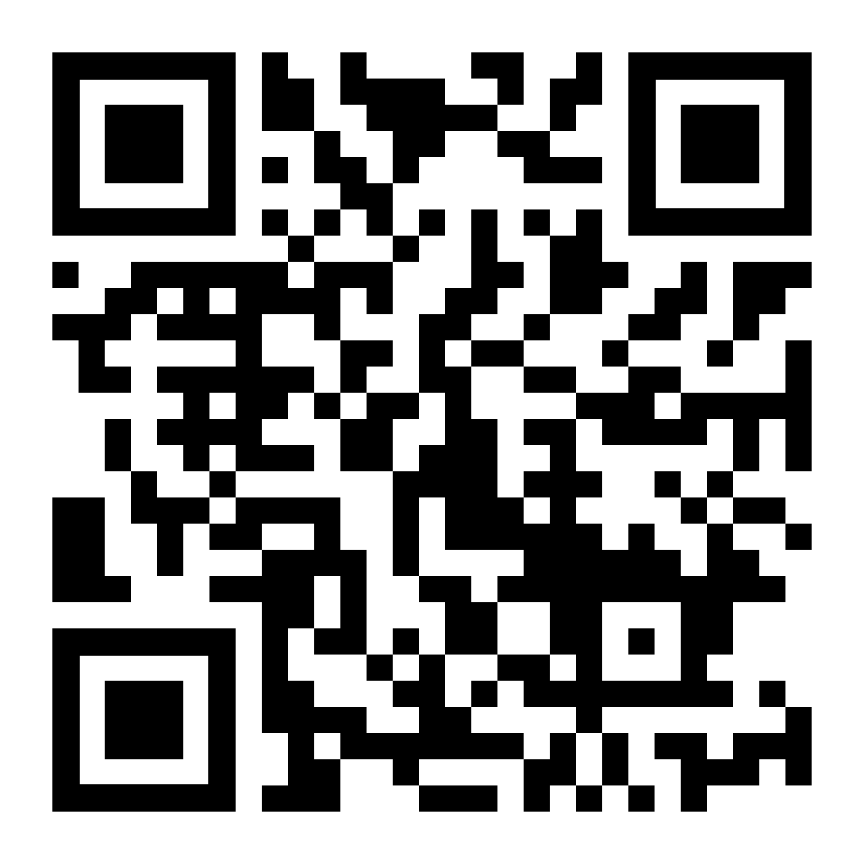
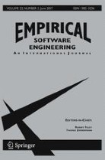


Learning by Sampling:
Learning behavioral family models from software product lines
Access the paper!
ICIS Seminar
Carlos Diego Nascimento Damasceno, Mohammad Reza Mousavi, Adenilso Simao
Journal paper published at the Empirical Software Engineering Journal
PhD research at University of Sao Paulo and University of Leicester
Notes:
Welcome everyone, I’m Diego and in this presentation I will show some of the main findings of a paper I recently published at the Empirical Software Engineering Journal. This paper is a result of a collaboration between the University of Sao Paulo, in Brazil, where I earned my PhD and the University of Leicester, in the UK.

Slide 2








Introduction
Configuration m
…
…
…
Configuration 2
Variability in space
…
Configuration 1
Version 1
Version 2
Version 3
Version n
Evolution over time
Evolution over time
K. Pohl, G. Böckle, and F. J. van der Linden, Software Product Line Engineering: Foundations, Principles and Techniques. Secaucus, NJ, USA: Springer-Verlag New York, Inc., 2005.
H. Chockler, D. Kroening, L. Mariani, and N. Sharygina, Eds., Validation of Evolving Software. Cham: Springer International Publishing, 2015.
M. S. Deutsch, ‘Tutorial Series 7 Software Project Verification and Validation’, Computer, vol. 14, no. 4, pp. 54–70, Apr. 1981
Notes:
Software systems tend to be constantly modified over time in order to correct faults, improve attributes, and cope with changes within their operational environment…
On top of that, software projects may also require multiple variants (or configurations) to be simultaneously developed to cope with different stakeholders or platforms…
Unfortunately, such diversity often comes with a higher risk for human mistakes and threats to software quality.

Slide 3

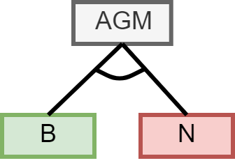

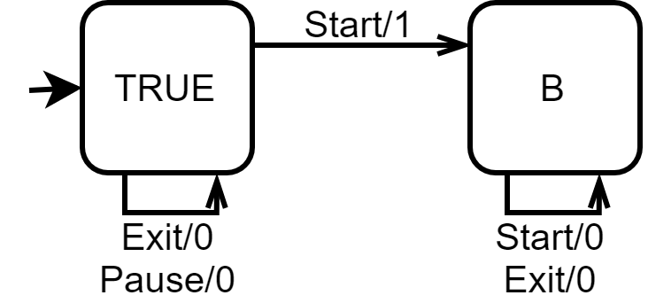


Context
Analysis and modeling of SPLs
Product-based strategies
Exhaustive analysis
Configuration sampling
Missing models
Redundant analysis
Scalability (e.g., exponential)
T. Thüm, S. Apel, C. Kästner, I. Schaefer, and G. Saake, ‘A Classification and Survey of Analysis Strategies for Software Product Lines’, ACM Comput. Surv., vol. 47, Jun. 2014
S. Oster, ‘Feature Model-based Software Product Line Testing’, PhD Thesis, Technische Universität, Darmstadt, 2012.
Notes:
Within the scope of SPLs, different modelling and analysis strategies can be applied to improve the quality of software product families.
In product-based strategies, software analysis techniques can be used to exhaustively verify all valid products of a product family or even a subsets of product configuration sampled according to some criteria.
However, the application of these techniques may become non-trivial due to missing models and redundant computations or even impractical due to the potentially large number of valid configurations.

Slide 4
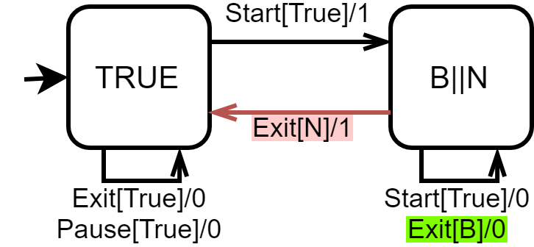
Context
Analysis and modeling of SPLs
Family-based strategies
Corner-stone of efficient model-based SPL analysis
Family models (or 150% models)
e.g., Featured Finite State Machine (FFSM)
Missing family models
Model maintenance and evolution
Commonalities/variabilities are unknown
T. Thüm, S. Apel, C. Kästner, I. Schaefer, and G. Saake, ‘A Classification and Survey of Analysis Strategies for Software Product Lines’, ACM Comput. Surv., vol. 47, no. 1, p. 6:1–6:45, Jun. 2014
S. Oster, ‘Feature Model-based Software Product Line Testing’, PhD Thesis, Technische Universität, Darmstadt, 2012.
V. Hafemann Fragal, A. Simao, and M. R. Mousavi, ‘Validated Test Models for Software Product Lines: Featured Finite State Machines’, in `FACS 2016.
Notes:
In order to address these issues in a more efficient way, we have the family-based strategies for SPL analysis.
The family-based strategies for SPL analysis rely on the so called family models (or 150% models) to express behavioral and strucutral variability by means of presence conditions.
Presence conditiona can be used to extend traditional notations, such as mealy machines, to indicate the circunstances in which specific states or transitions should be expected.
Featured finite state machines are one example of family-based modeling notation that provides the formal basis for variability-aware test generation.
But again, the application of these techniques may be complex due to the lack of models, their proper maintenance or even the lack of knowledge on the behavioral commonalities and variability of a product line.

Slide 5
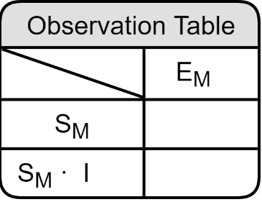

Context
Minimally Adequate Teacher (MAT)
Model Learning Algorithm
Equivalence Queries (EQ)
Model-Based Testing (MBT)
Yes || Counterexample
Output
Reset + Inputs
Formulate
Membership Queries (MQ)
Query Output
System Under Learning (SUL)
D. Angluin, ‘Learning regular sets from queries and counterexamples’, Information and Computation, vol. 75, no. 2, pp. 87–106, 1987
F. Vaandrager, ‘Model Learning’, Commun. ACM, vol. 60, no. 2, pp. 86–95, Jan. 2017
C. D. N. Damasceno, M. R. Mousavi, and A. Simao, ‘Learning to reuse: Adaptive model learning for evolving systems’, in 15th Integrated Formal Methods, Bergen, Norway, 2019
Notes:
To address the lack of software models, studies have shown that automata learning can provide efficient and effective means to formulate hypotheses about the states and transitions of a system.
Recent investigations have also explored ways to cope with software updates and speed up learning by means of reusing queries from previous learning processes.
However, to date, there is still limited research on how to identify behavioural variability in product families.

Slide 6




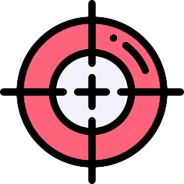
Research Problem
How can we leverage model learning concepts to the task of behavioral variability modeling?
Can we obtain models precise enough if we sample configurations?
Notes:
To fill this gap, we proposed to investigate the following research problem:

Slide 7
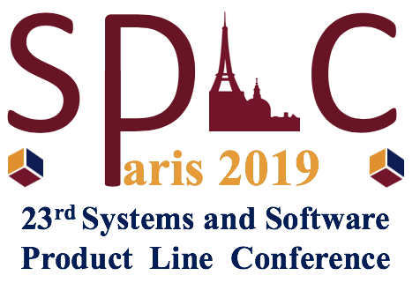

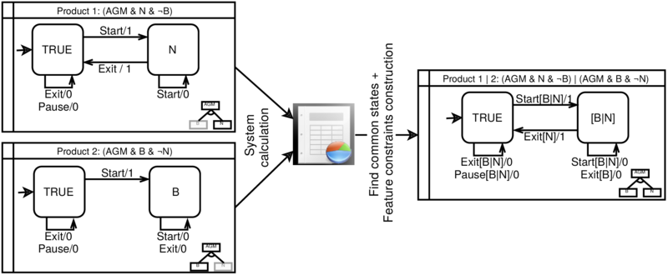
FFSM Difference (FFSM _{Diff})
The FFSM _{Diff} can learn FFSMs from a product models by employing state-based model comparison and express product-specific behaviors with feature constraints using feature model analysis
C. D. N. Damasceno, M. R. Mousavi, and A. Simao, ‘Learning from Difference: An Automated Approach for Learning Family Models from Software Product Lines’, in 23rd International Systems and Software Product Line Conference, 2019
Notes:
This investigation had a starting point at a study previously published at the SPLC 2019 where we introduced the FFSM diff algorithm for learning FFSMs from product models...

Slide 8
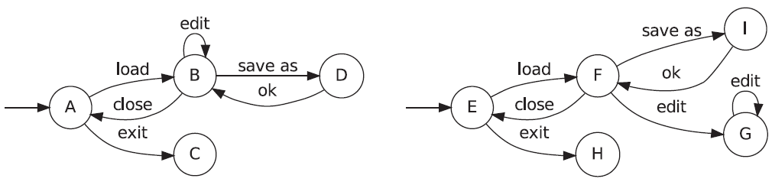
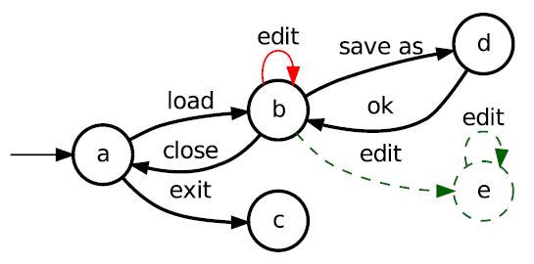

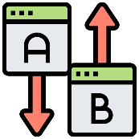
State-based model comparison (LTS _{Diff} algorithm)
Comparing the Structures of Two State Machines of a Text Editor
N. Walkinshaw and K. Bogdanov, ‘Automated Comparison of State-Based Software Models in Terms of Their Language and Structure’, ACM TOSEM, vol. 22, 2013
Notes:
State-based model comparison provides an approach to calculate the structural similarity between models in terms of the actual added, removed and common states and transitions that govern the behavior.

Slide 9
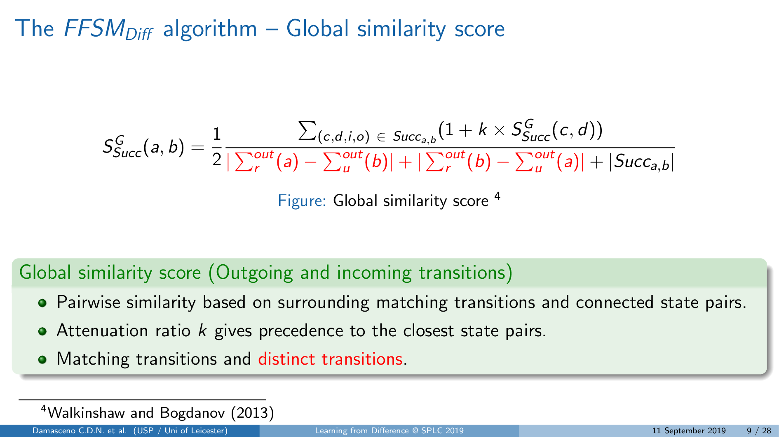
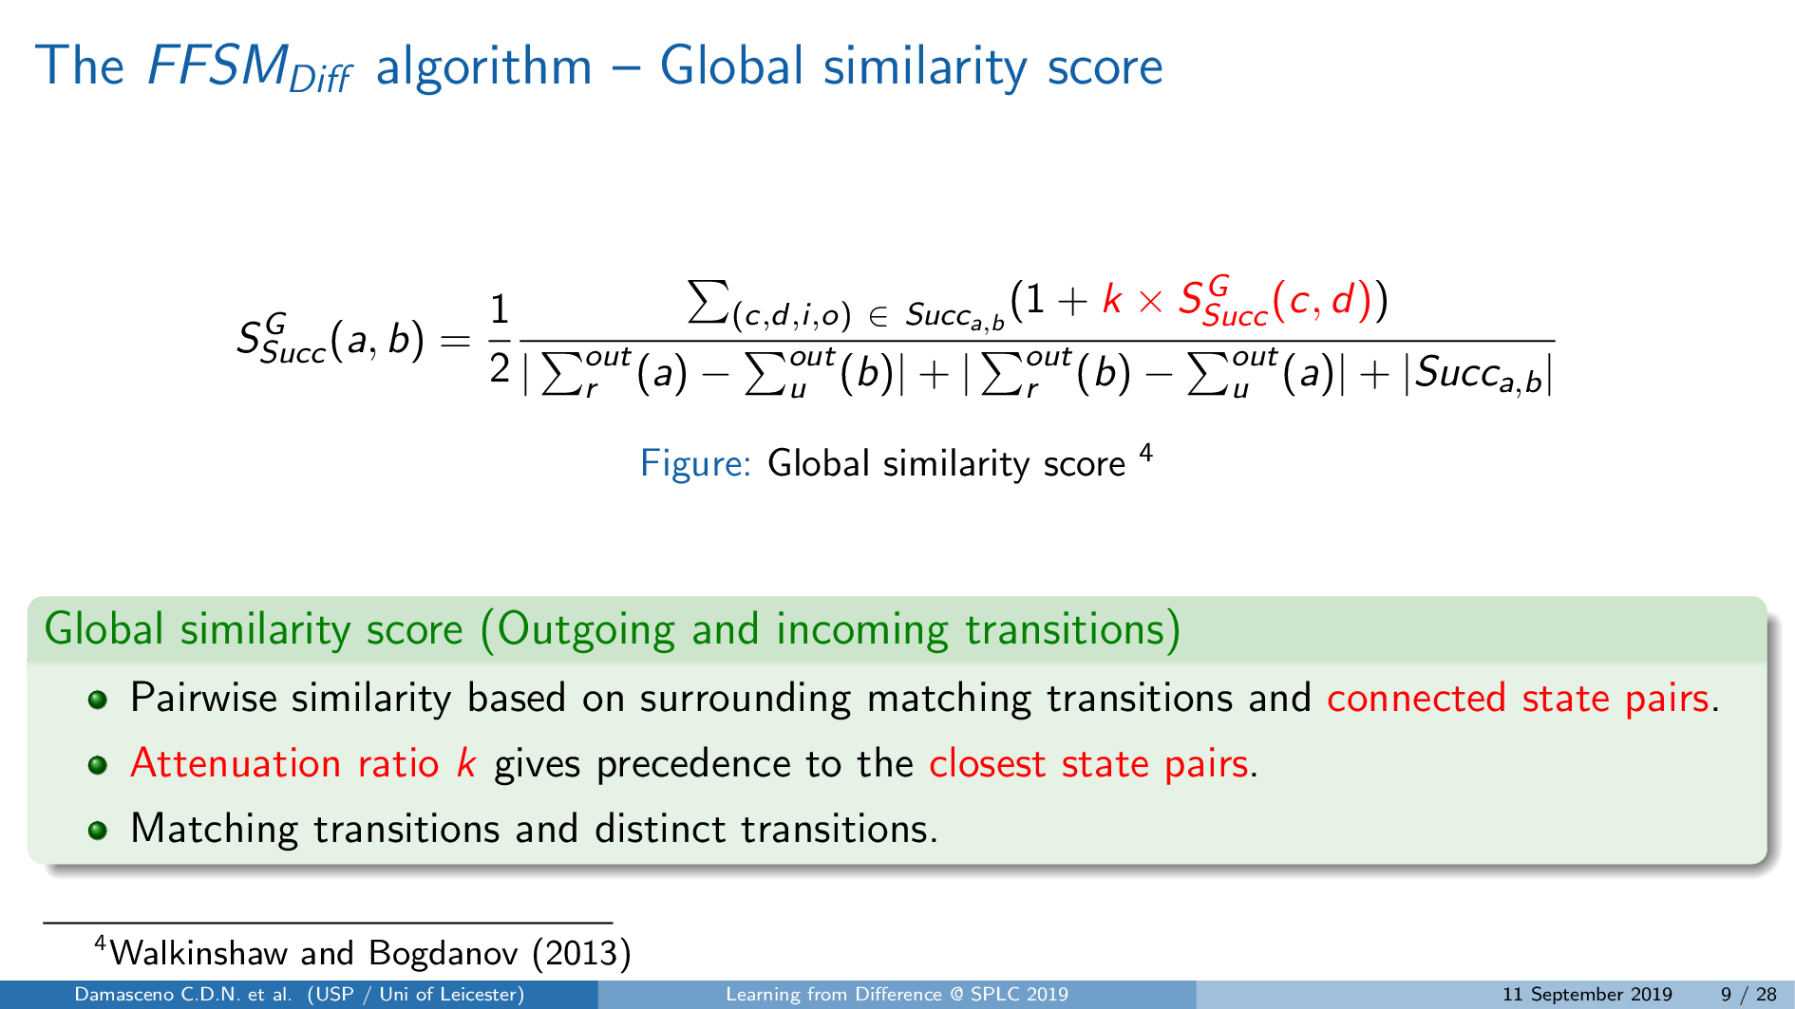
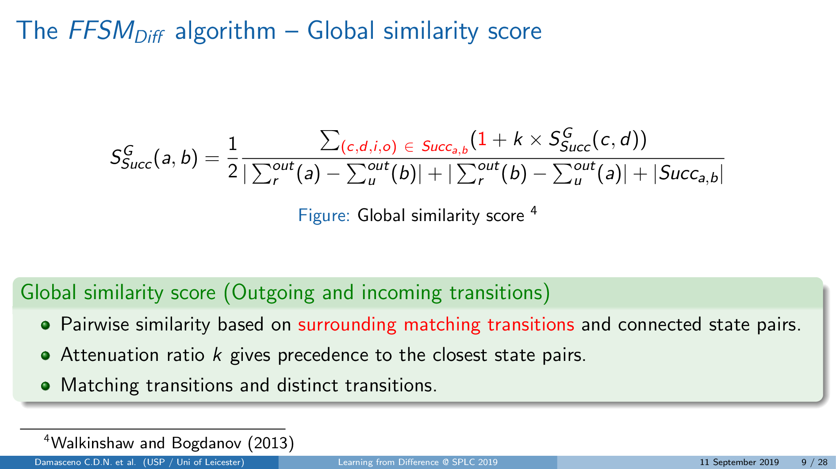
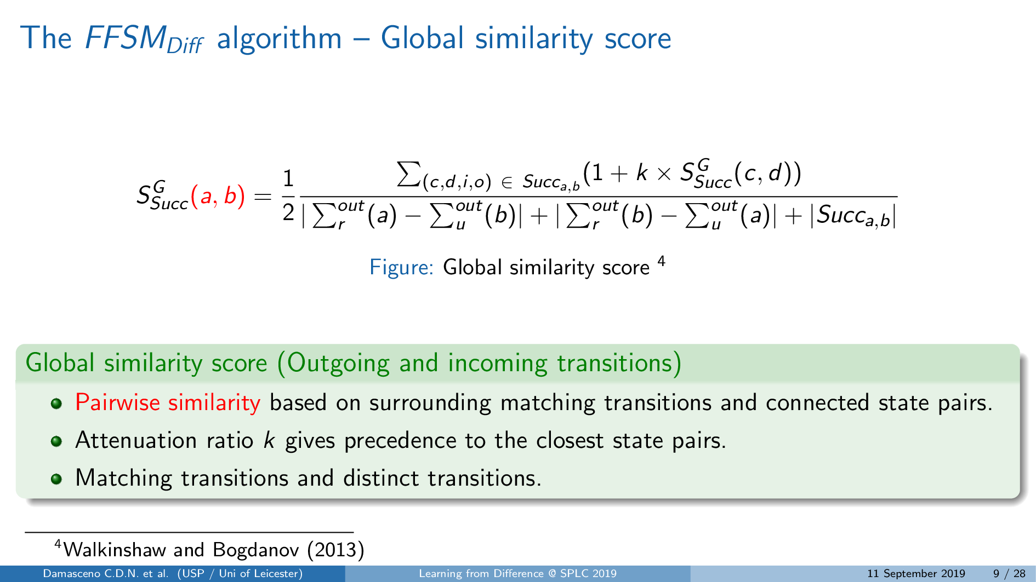
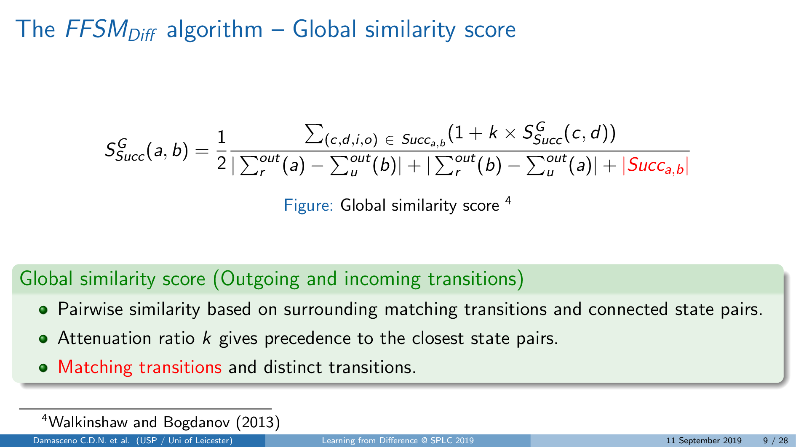
State-based model comparison (LTS _{Diff} algorithm)
N. Walkinshaw and K. Bogdanov, ‘Automated Comparison of State-Based Software Models in Terms of Their Language and Structure’, ACM TOSEM, vol. 22, 2013
Notes:
To calculate this similarity, we use a score for all pairs of states from two models based on surrounding matching...

Slide 10
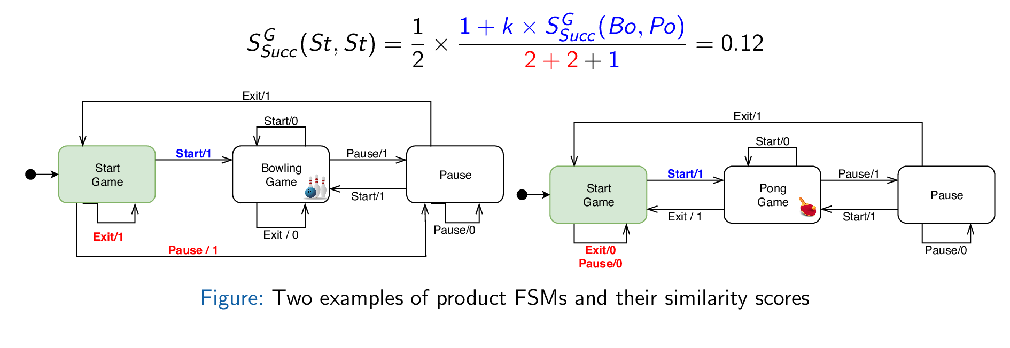
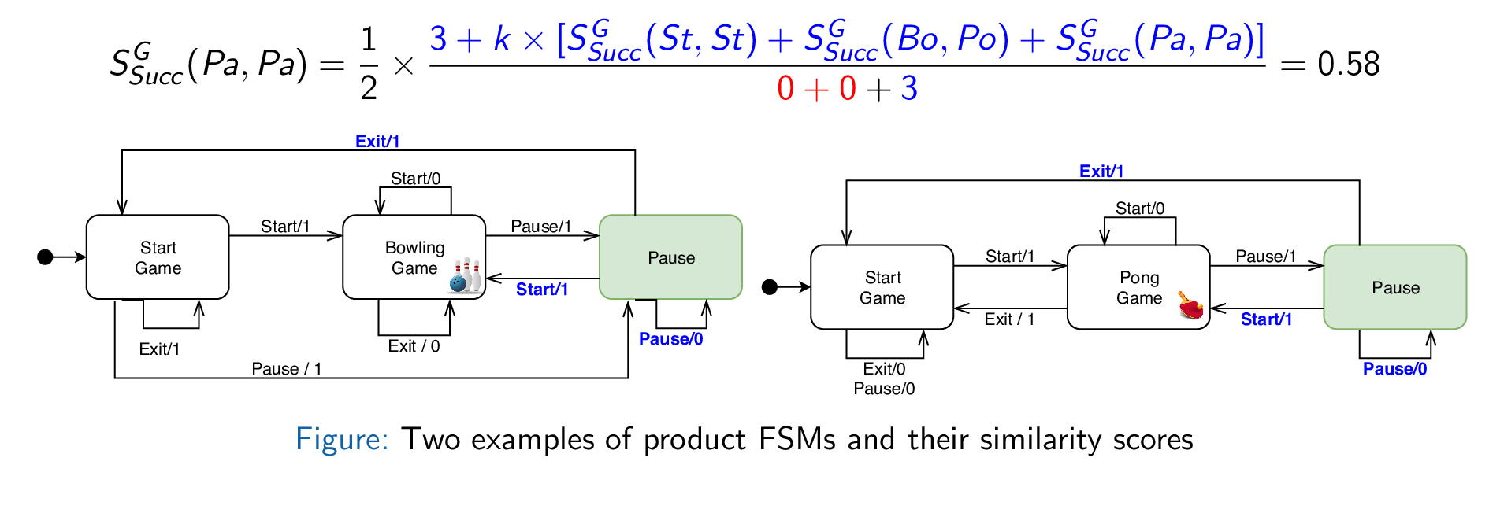
State-based model comparison (LTS _{Diff} algorithm)
N. Walkinshaw and K. Bogdanov, ‘Automated Comparison of State-Based Software Models in Terms of Their Language and Structure’, ACM TOSEM, vol. 22, 2013
Notes:
Here we have two examples of similarity scores for state pairs with different numbers of matching transitions…

Slide 11
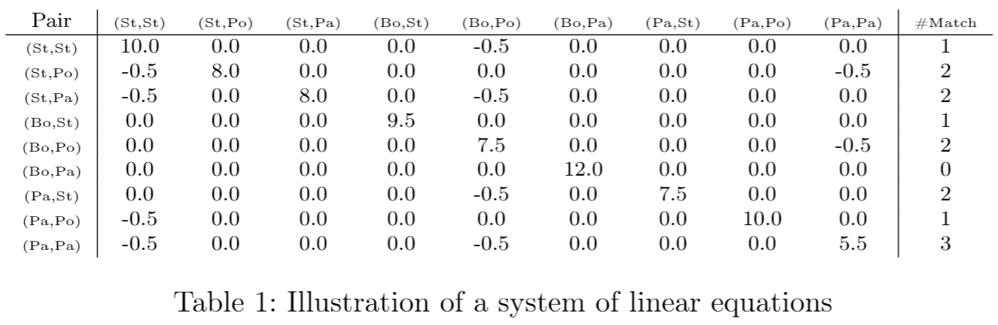
State-based model comparison (LTS _{Diff} algorithm)
Notes:
The problem of calculating the similarity scores is represented by a set of equations, one for each state pair with their respective coefficients indicating reachable state pairs and their total number of matching transitions

Slide 12
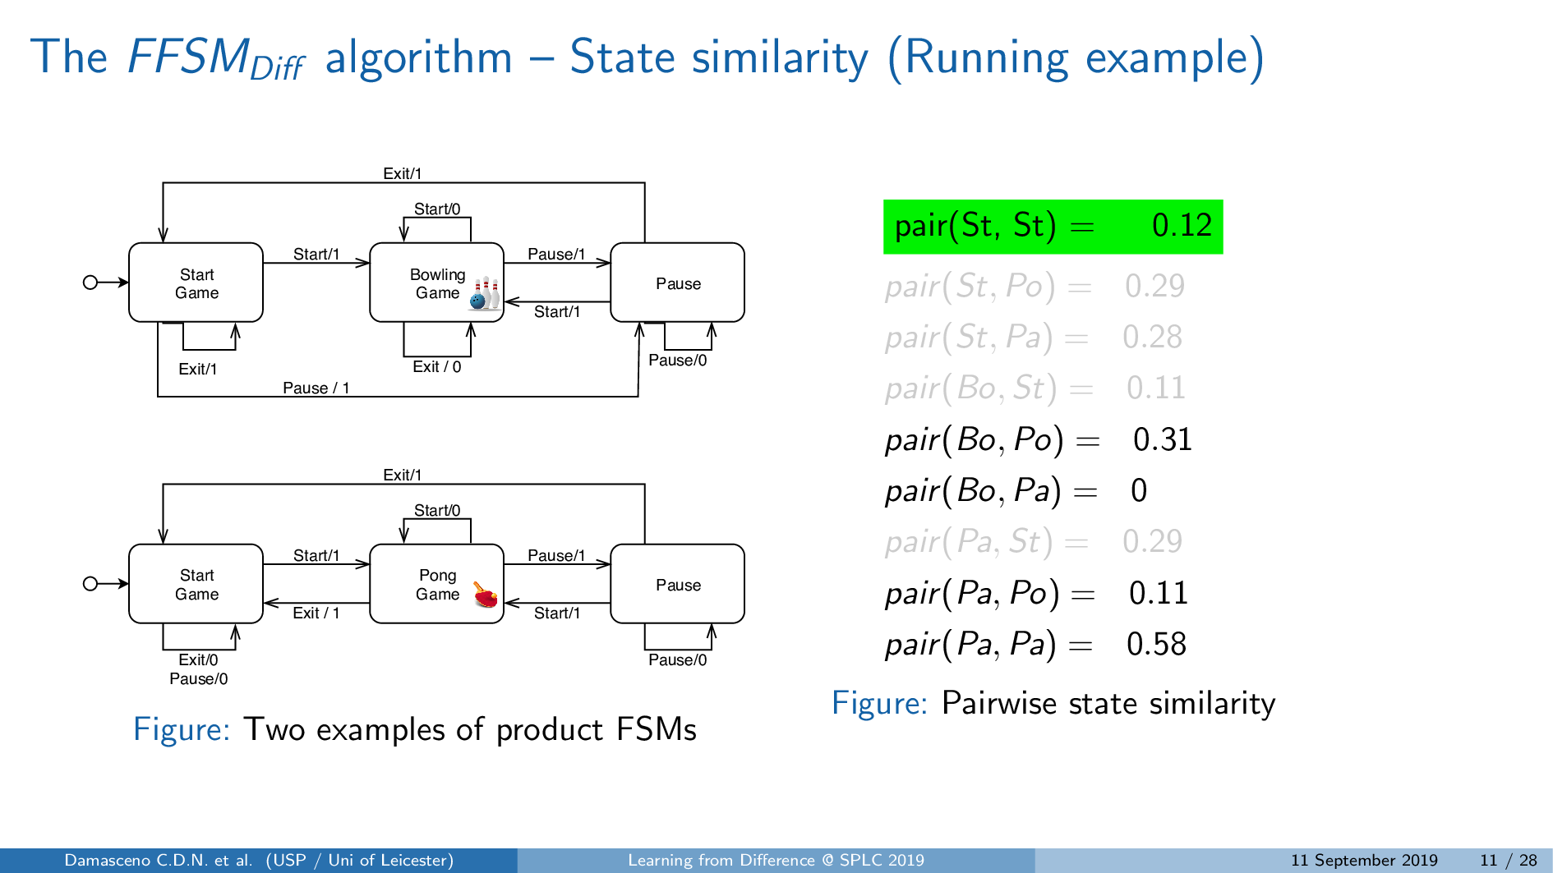
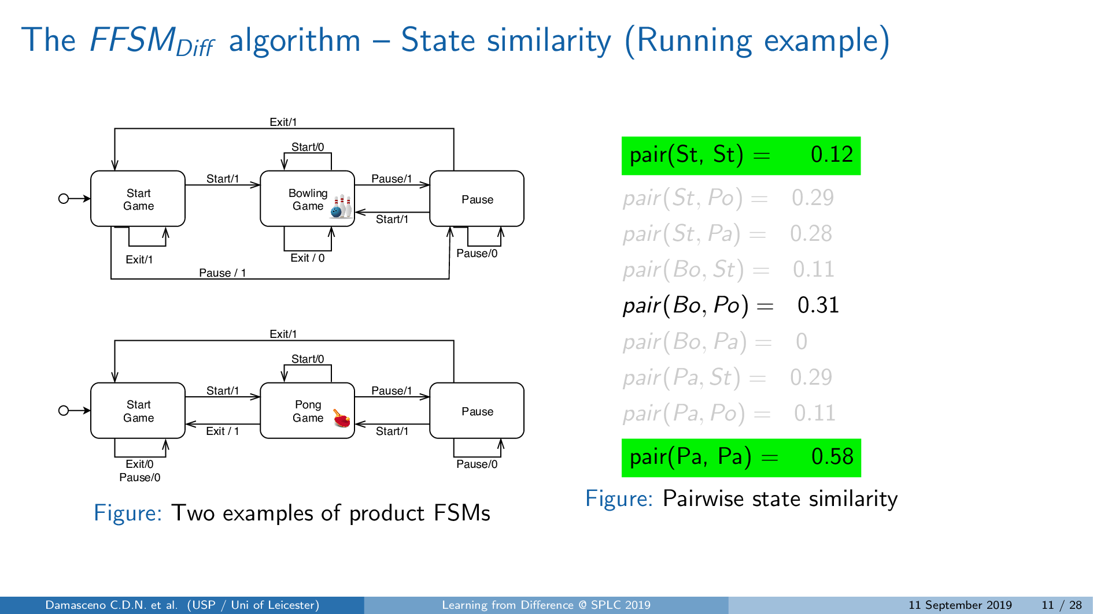
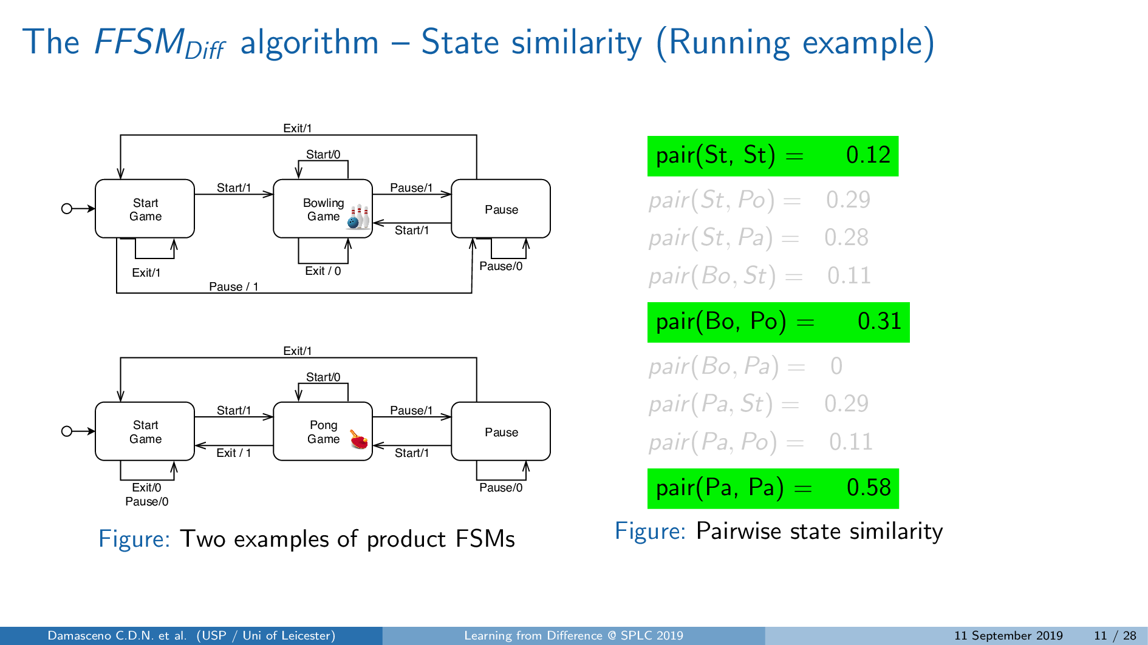
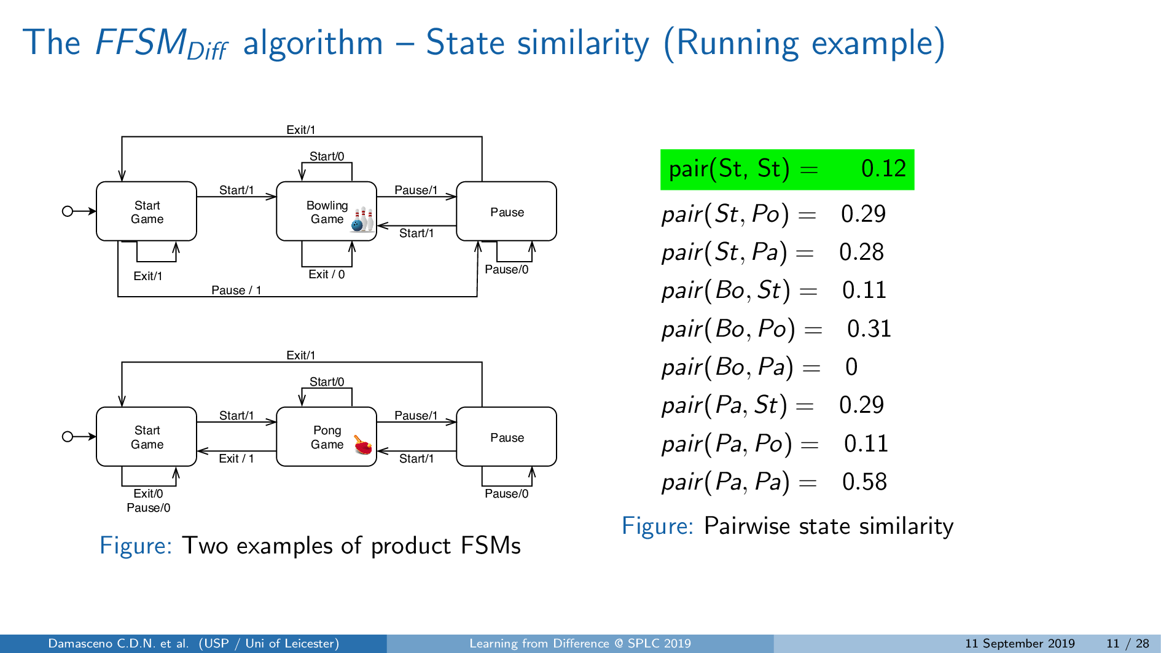
The FFSM _{Diff} algorithm
Notes:
Once the system is solved, we iterate through the similarity scores from the initial states pair, and then from the state pair with highest similarity to the lowest one.
State pairs sharing the same state are removed throughout the process.

Slide 13
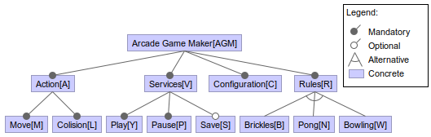
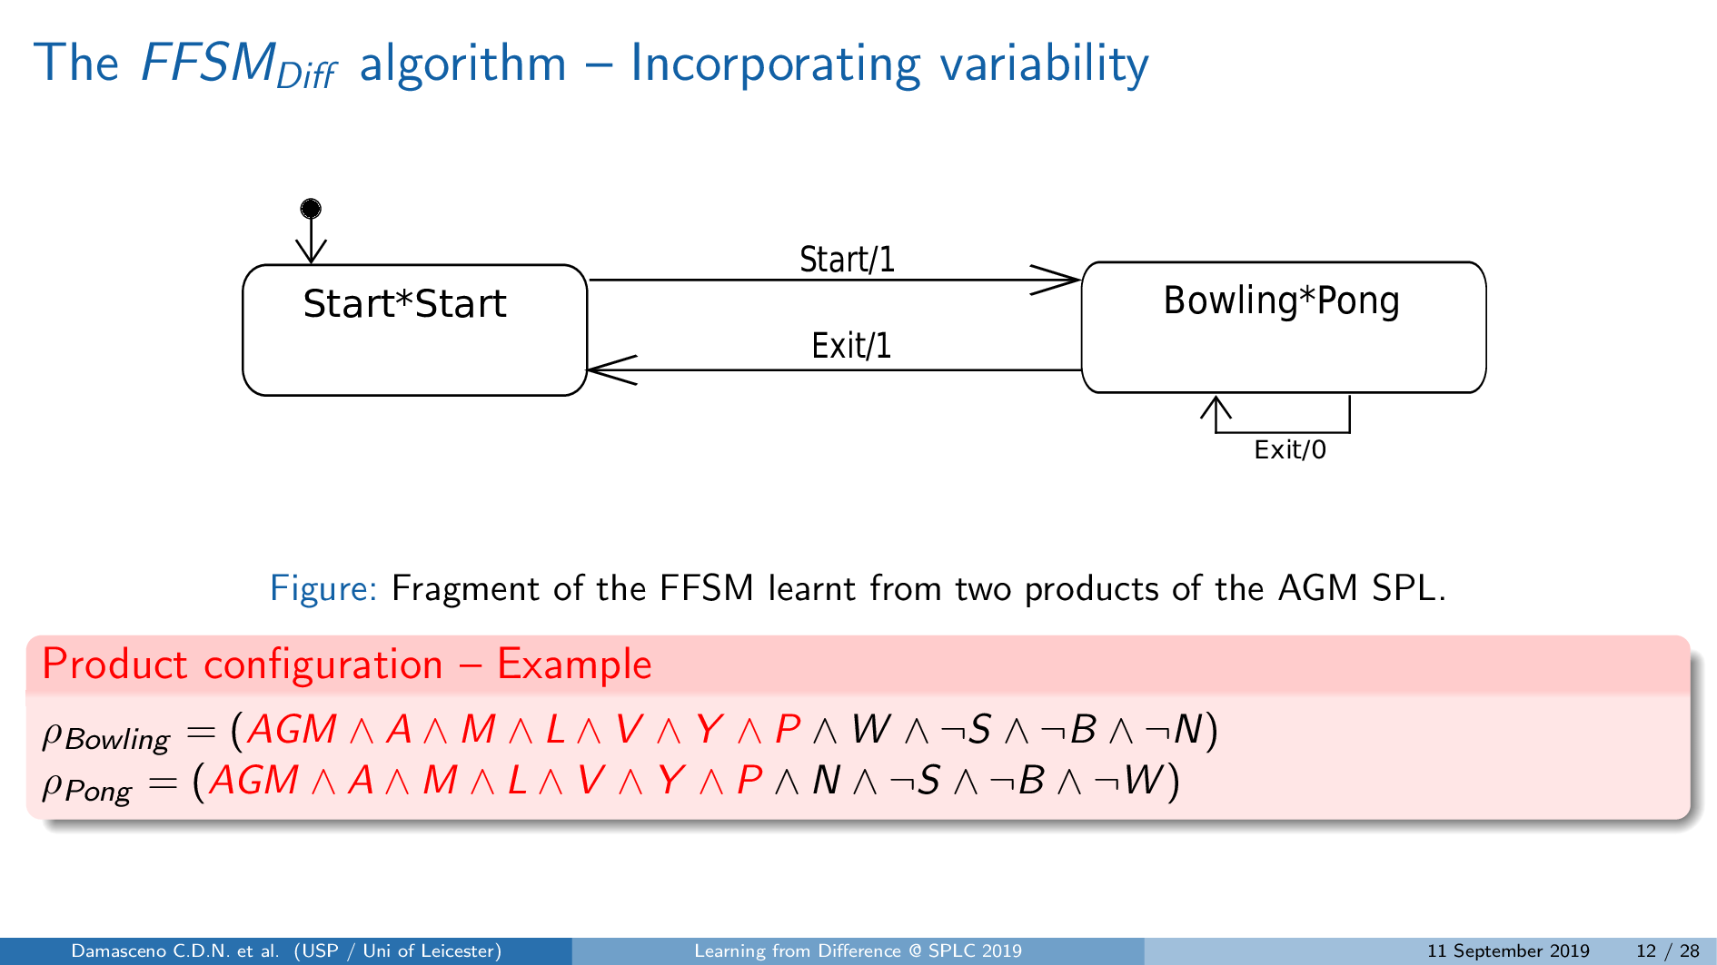
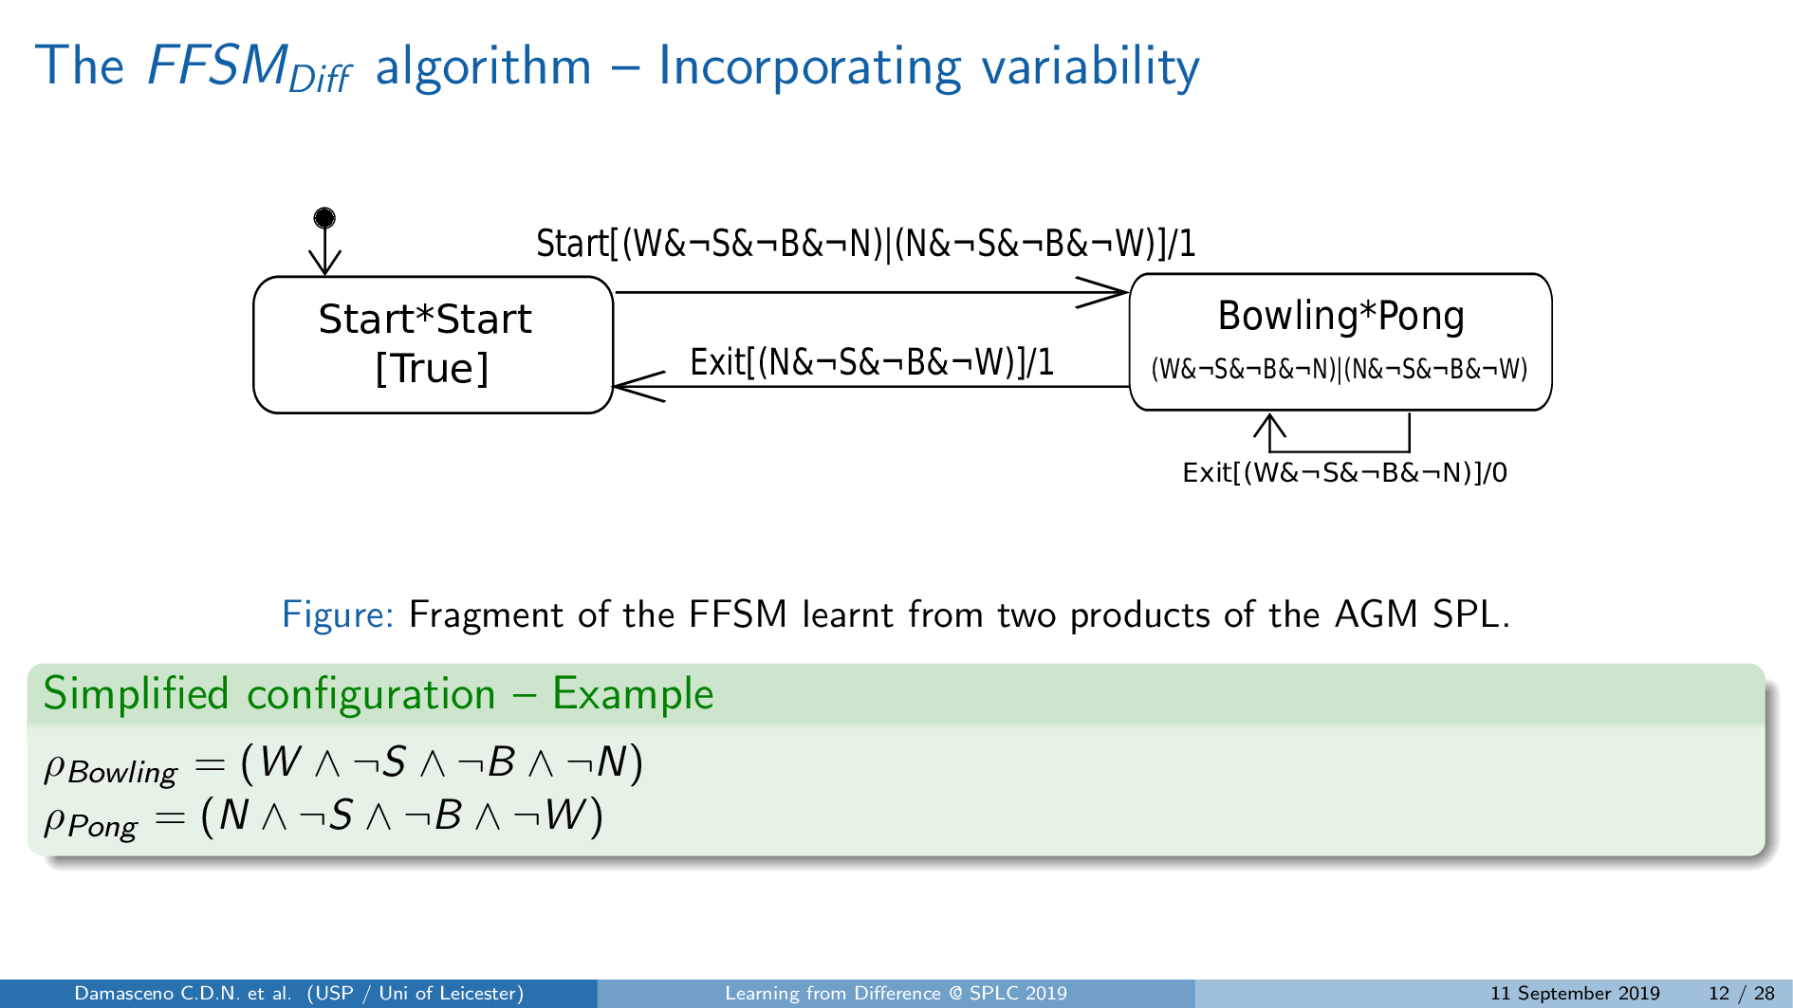
The FFSM _{Diff} algorithm
V. Hafemann Fragal, A. Simao, and M. R. Mousavi, ‘Validated Test Models for Software Product Lines: Featured Finite State Machines’, in `FACS 2016.
D. Benavides, S. Segura, and A. Ruiz-Cortés, ‘Automated analysis of feature models 20 years later: A literature review’, Information Systems, vol. 35, no. 6, pp. 615–636, 2010
Notes:
Once the matches are found, we merge the models and annotate the states and transitions with their simplified configurations as feature constraints

Slide 14
Empirical evaluation

Slide 15
Research Questions
RQ1) Effectiveness on learning succinct family models, given the total size of the product pairs under learning
RQ2) Size of learned family models vs. configuration similarity
RQ3) Effectiveness in learning succinct family models, given the total size of the hand-crafted family models
RQ4) Effectives on learning precise family models by sampling vs. exhaustive?
Notes:
Size of products → number of transitions and number of states
Configuration similarity → Hamming distance betweenproduct configurations (FeatureIDE)

Slide 16
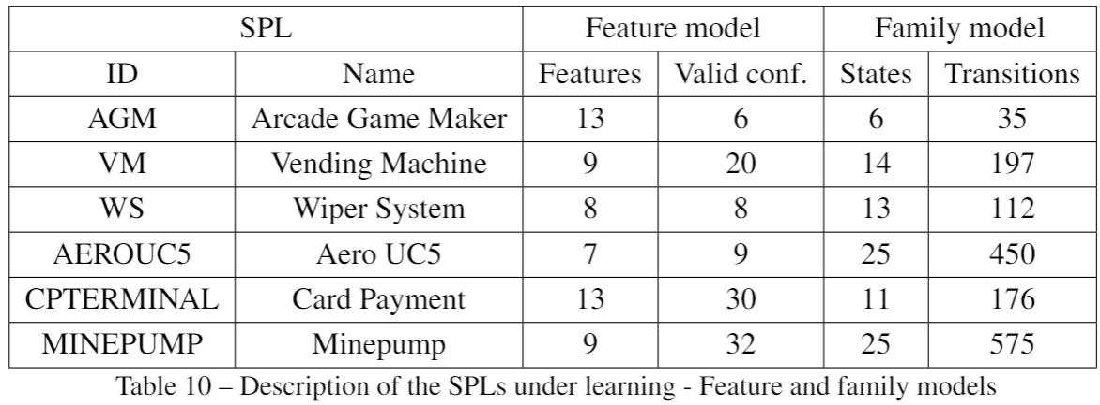
Subject Systems
A. Classen, ‘Modelling with FTS: a Collection of Illustrative Examples’. 2010, [Online]. Available: https://researchportal.unamur.be/en/publications/modelling-with-fts-a-collection-of-illustrative-examples
H. Samih, H. L. Guen, R. Bogusch, M. Acher, and B. Baudry, ‘Deriving Usage Model Variants for Model-Based Testing: An Industrial Case Study’, in Proceedings of the ICECCS 2014
X. Devroey, G. Perrouin, A. Legay, P.-Y. Schobbens, and P. Heymans, ‘Search-based Similarity-driven Behavioural SPL Testing’, in Proceedings of the VaMoS 2016
V. Hafemann Fragal, A. Simao, and M. R. Mousavi, ‘Validated Test Models for Software Product Lines: Featured Finite State Machines’, in `FACS 2016.
Notes:
Most of these models were originally designed as FTS
These models were made available in a “collection of examples of FTS“ that has been widely used in studies on Family-based analysis of SPLs
I transcribed them from FTSs to FFSMs
Particularly, the AEROUC5 is an example of FTS inspired by a realistic model from the avionic domain (it is an industrial situational awareness system for helicopters)

Slide 17



Experiment Design
M. Isberner, F. Howar, and B. Steffen, ‘The Open-Source LearnLib’, in CAV 2015
Apache, Commons Math: The Apache Commons Mathematics Library. 2016.
T. Thüm, et al., ‘FeatureIDE: An extensible framework for feature-oriented software development’, Science of Computer Programming, vol. 79, 2014

Slide 18

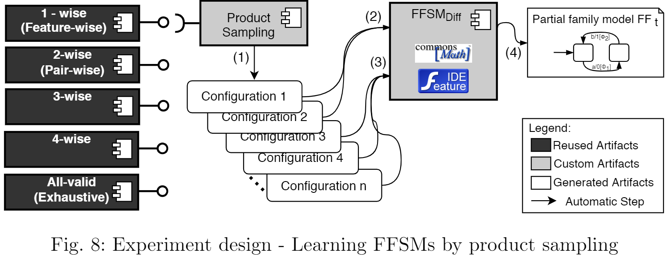
Experiment Design (cont.)
M. Isberner, F. Howar, and B. Steffen, ‘The Open-Source LearnLib’, in CAV 2015
Apache, Commons Math: The Apache Commons Mathematics Library. 2016.
T. Thüm, et al., ‘FeatureIDE: An extensible framework for feature-oriented software development’, Science of Computer Programming, vol. 79, 2014

Slide 19
Analysis of results

Slide 20
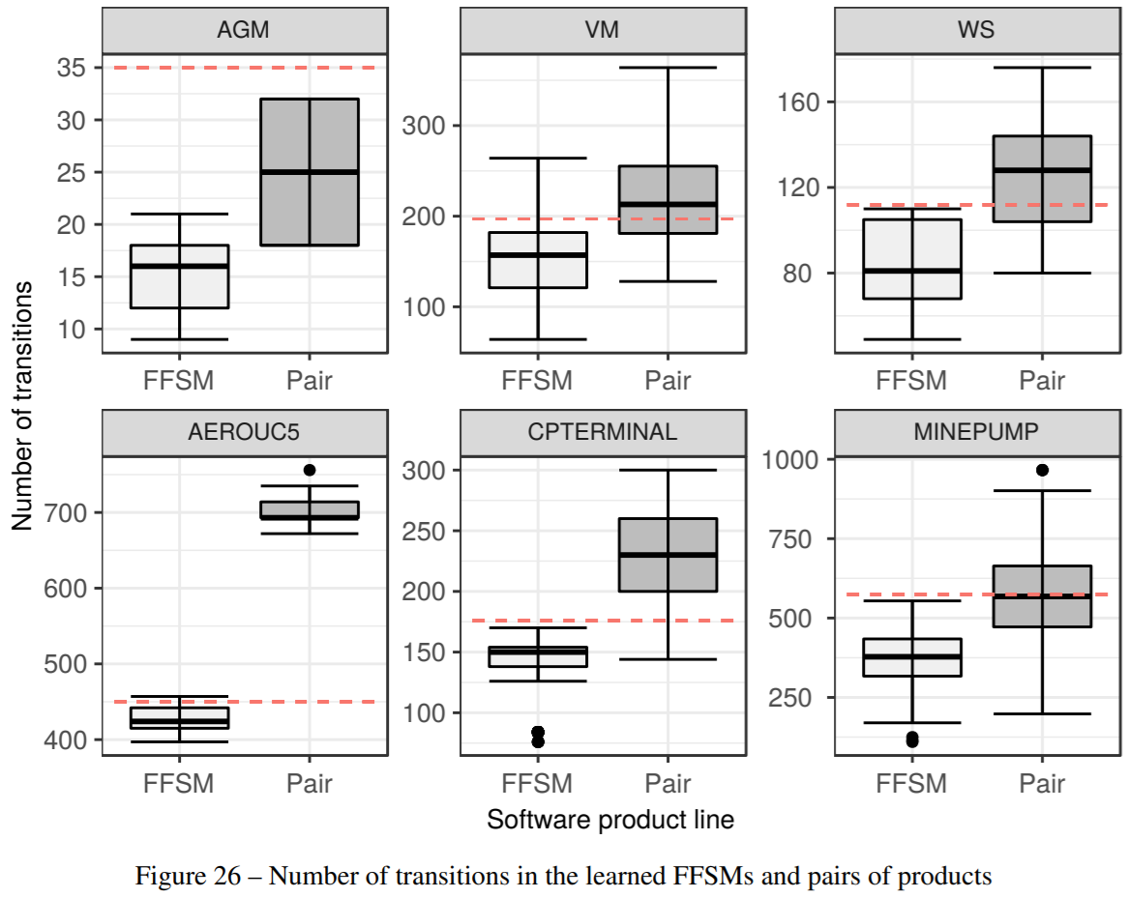
Analysis of Results (RQ1 and RQ3 – Size of Product Pairs/Handcrafted)
Mann-Whitney-Wilcoxon statistical test
Vargha-Delaney’s Â effect size

Slide 21
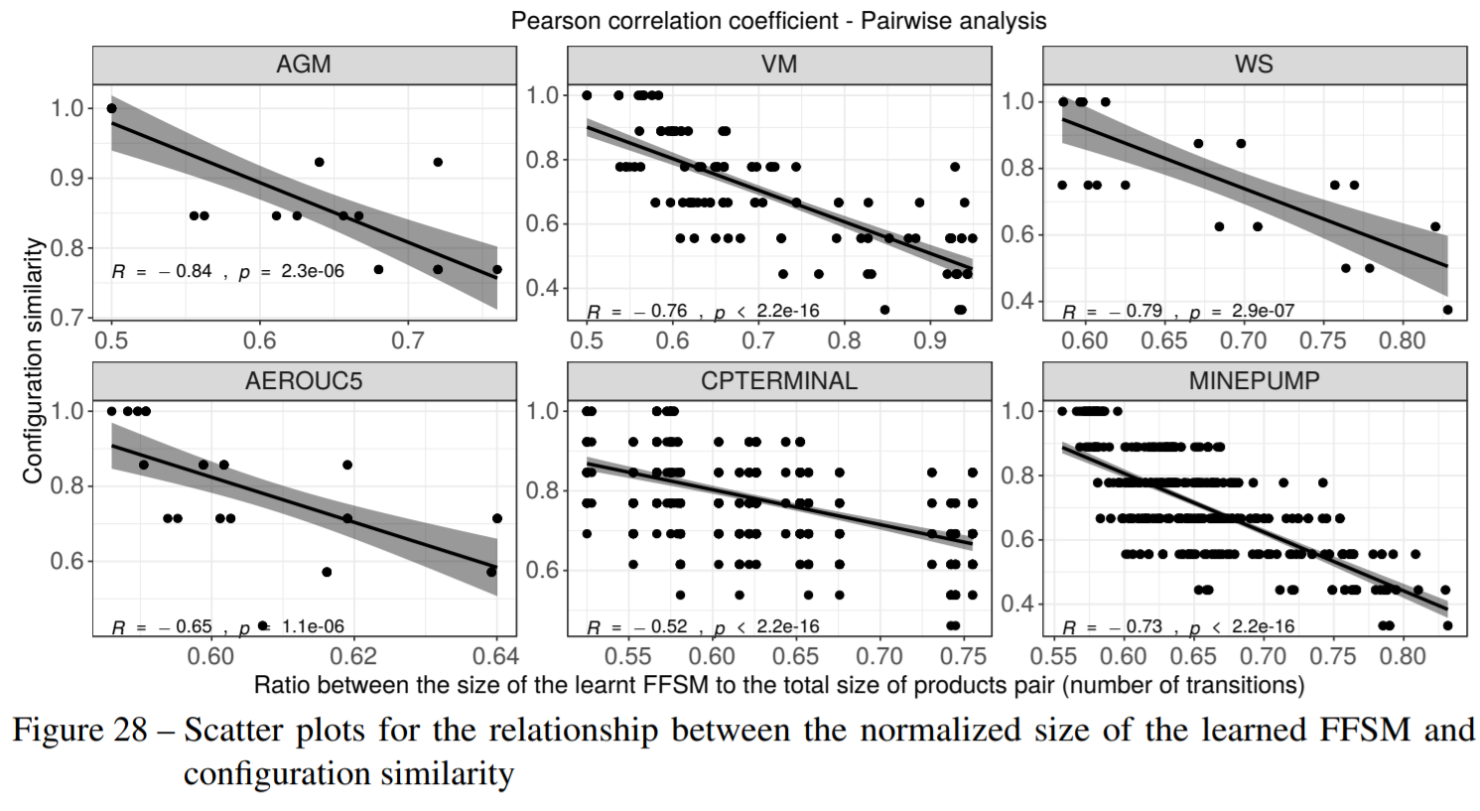
Analysis of Results (RQ2 – Configuration similarity)
Pearson correlation coefficient

Slide 22
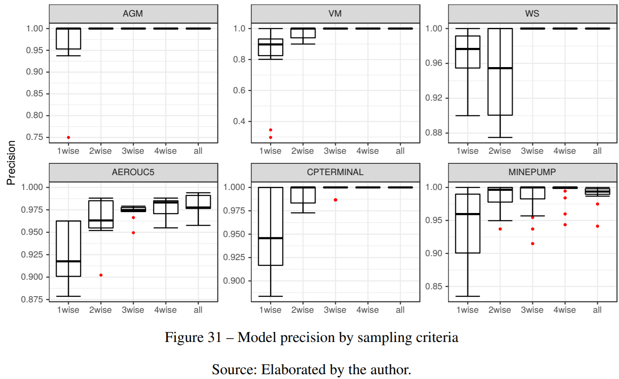
Analysis of Results (RQ4 – Learning by Sampling)
More precise family models
Higher values of T
Mann-Whitney-Wilcoxon statistical test
Vargha-Delaney’s Â effect size

Slide 23
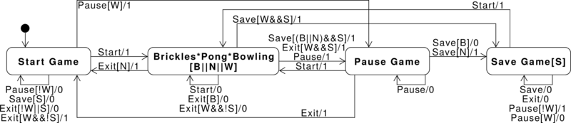
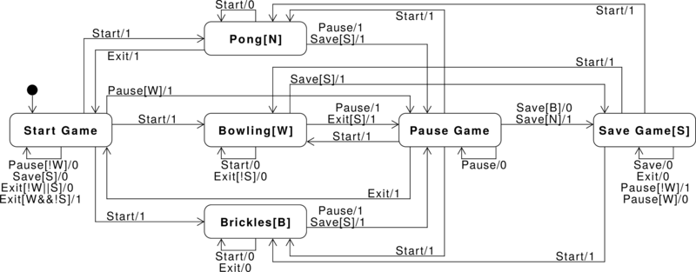
Analysis of Results (RQ4 – Learning by Sampling)
V. H. Fragal, ‘Automatic generation of configurable test-suites for software product lines’, PhD Thesis, Universidade de São Paulo, 2017.
Notes:
In red, we have the original size of the hand-crafted FFSMs

Slide 24
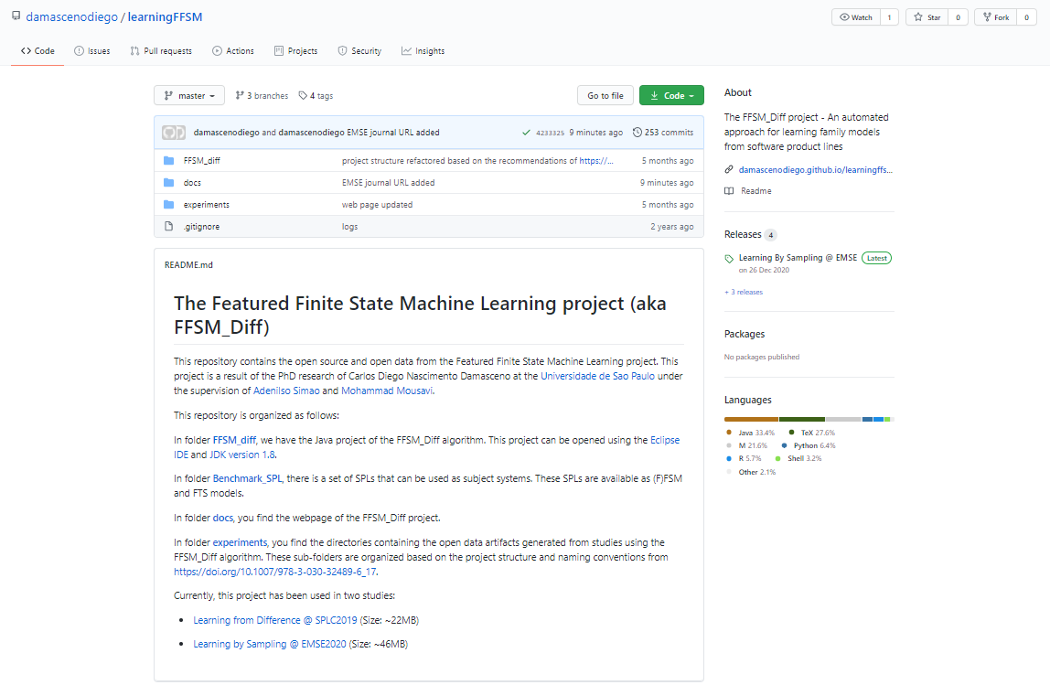
Analysis of Results (Software artifacts)
https://github.com/damascenodiego/learningFFSM

Slide 25
Final remarks

Slide 26

Summary
Learn fresh FFSMs from products pairs
Especially if there is high feature reuse (i.e., configuration similarity)
Incorporate new product behaviour into an existing FFSM
Family model recovery (e.g., reverse engineering, re-engineering)
Sampling lead to models as precise as those from exhaustive learning
Higher “T” values lead to higher coverage
Sampling can be helpful to family model learning

Slide 27
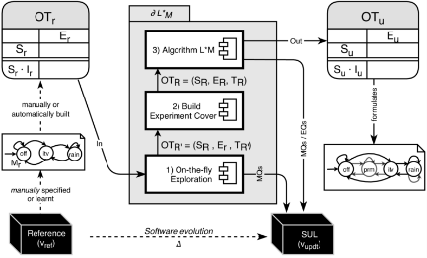
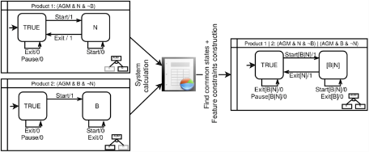
Part of the contribution of my PhD Thesis
Learning to Reuse
Learning from Differences
Learning by Sampling
C. D. N. Damasceno, M. R. Mousavi, and A. Simao, ‘Learning to reuse: Adaptive model learning for evolving systems’, in 15th Integrated Formal Methods, Bergen, Norway, 2019
C. D. N. Damasceno, M. R. Mousavi, and A. Simao, ‘Learning from Difference: An Automated Approach for Learning Family Models from Software Product Lines’, in 23rd International Systems and Software Product Line Conference, 2019
C. D. N. Damasceno, M. R. Mousavi, and A. Simao, ‘Learning by sampling: Evaluating t-wise sampling for learning family models’. Empirical Software Engineering, 2020.

Slide 28
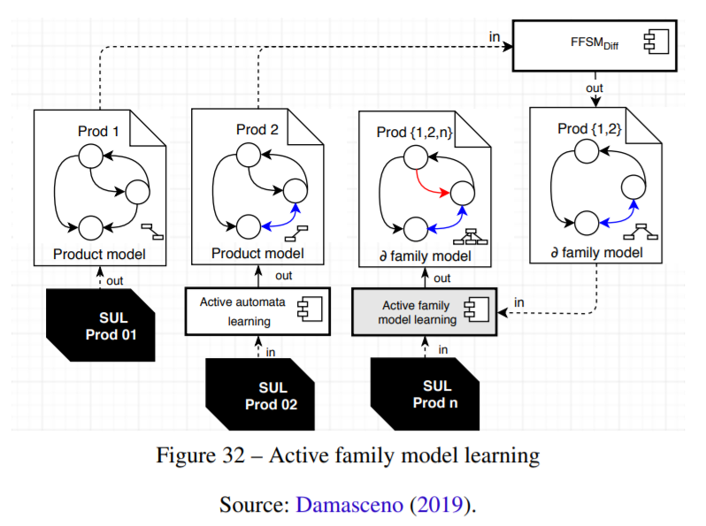
Future Work
Learning to Reuse
Active family model learning
Incremental Configurable Queries
Fingerprinting evolving systems
Learning from Differences
Learning by Sampling
C. D. N. Damasceno, ‘Learning From Families: Inferring Behavioral Variability From Software Product Lines’, presented at the PhD Symposium at Integrated Formal Methods, Bergen, Norway, 2019.
M. Al-Hajjaji, S. Krieter, T. Thüm, M. Lochau, and G. Saake, ‘IncLing: Efficient Product-Line Testing Using Incremental Pairwise Sampling’, in Proceedings of the GPCE 2016
G. Shu and D. Lee, ‘Network Protocol System Fingerprinting - A Formal Approach’, in Proceedings of the IEEE INFOCOM 2006

Slide 29




Thank you

